Slide 1
Tropical evergreen forest
By kayalvizhi

Slide 2
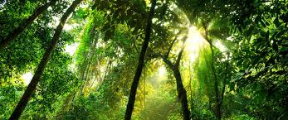
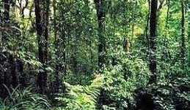
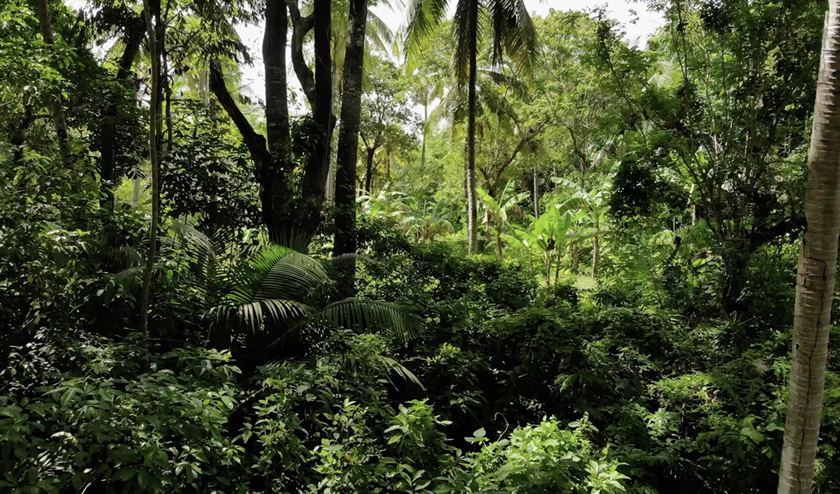
What is tropical evergreen forest ?
Tropical evergreen forests are dense, multi-layered, and harbour many types of plants and animals. These forests are found in the areas receiving heavy rainfall which is more than 200 cm annual rainfall. They are very dense. Even the sunlight does not reach the ground. Numerous species of trees are found in these forests. Tropical rainforest is the other name for tropical evergreen forest.

Slide 3
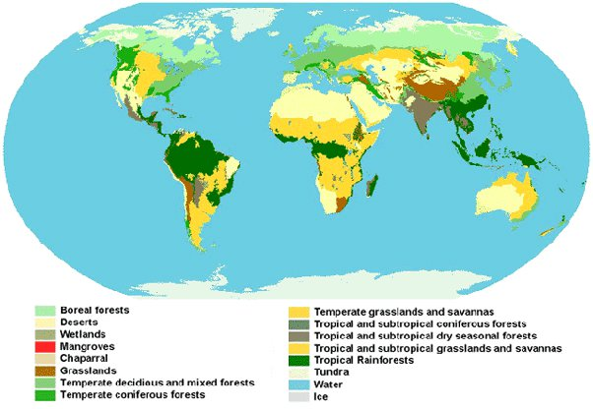
Where is it found internationally ?

Slide 4
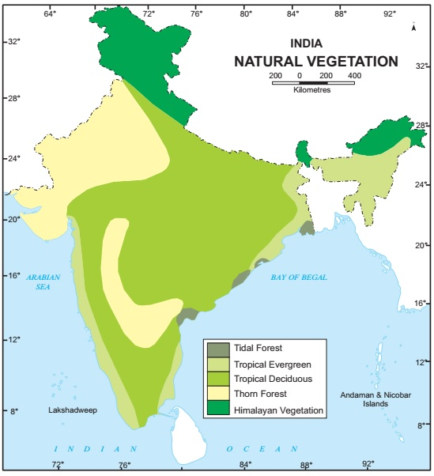
Where is it found in india ?

Slide 5
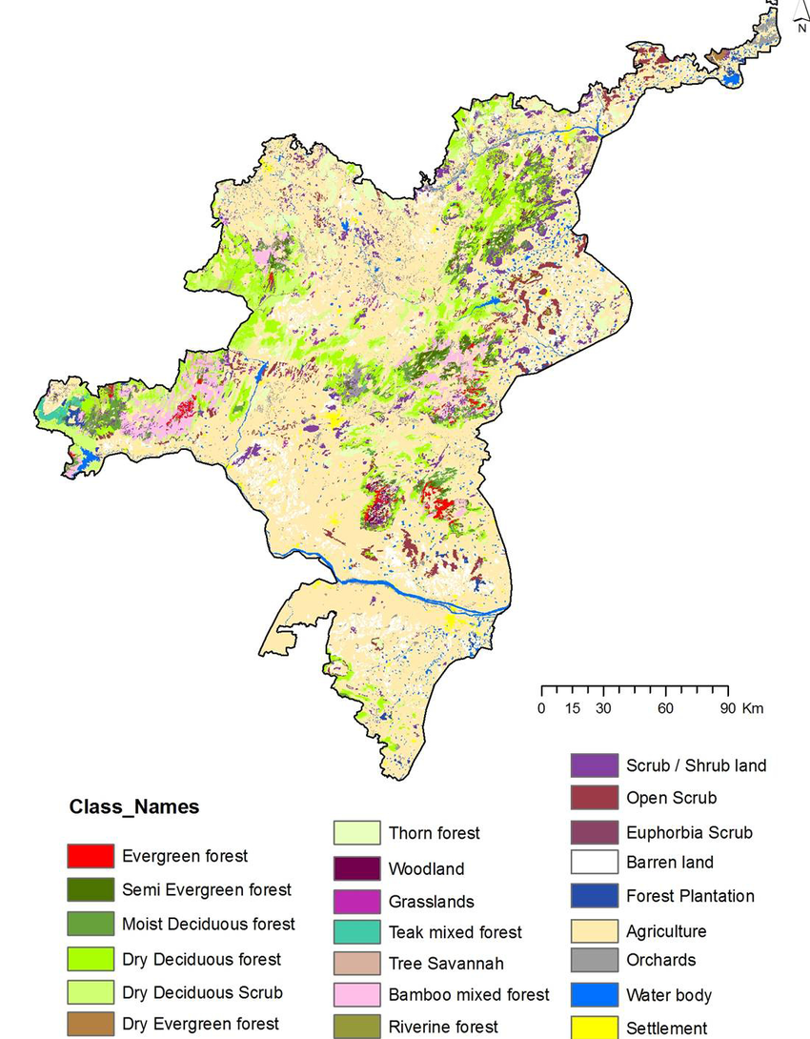
Where is it found in tamil nadu ?

Slide 6
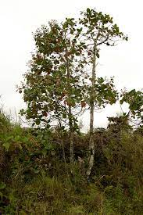
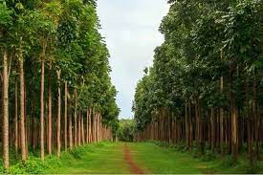
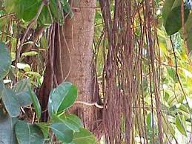
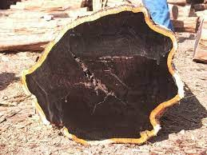
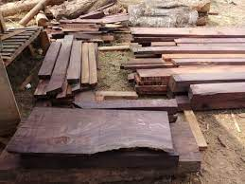
Types of vegetation in tropical evergreen forest
Since the region is warm and wet throughout the year, it has a luxuriant vegetation of all kinds trees, shrubs, and creepers giving it a multilayered structure. Some of the commercially important trees of this forest are ebony, mahogany, rosewood, rubber and cinchona.

Slide 7
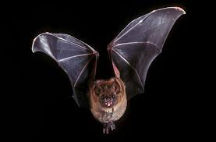
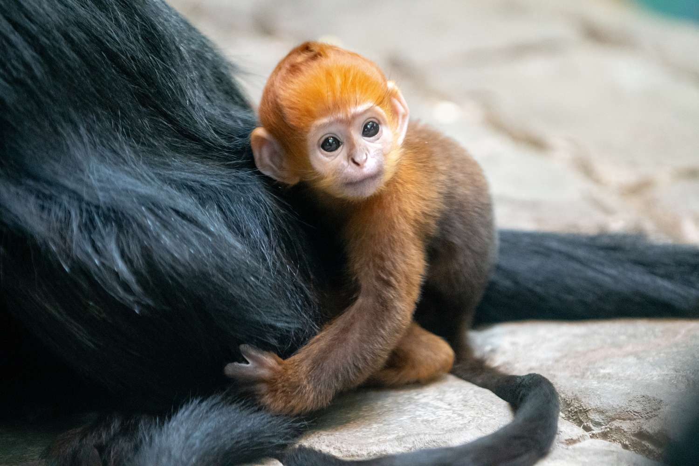
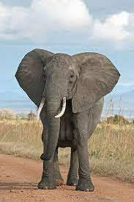
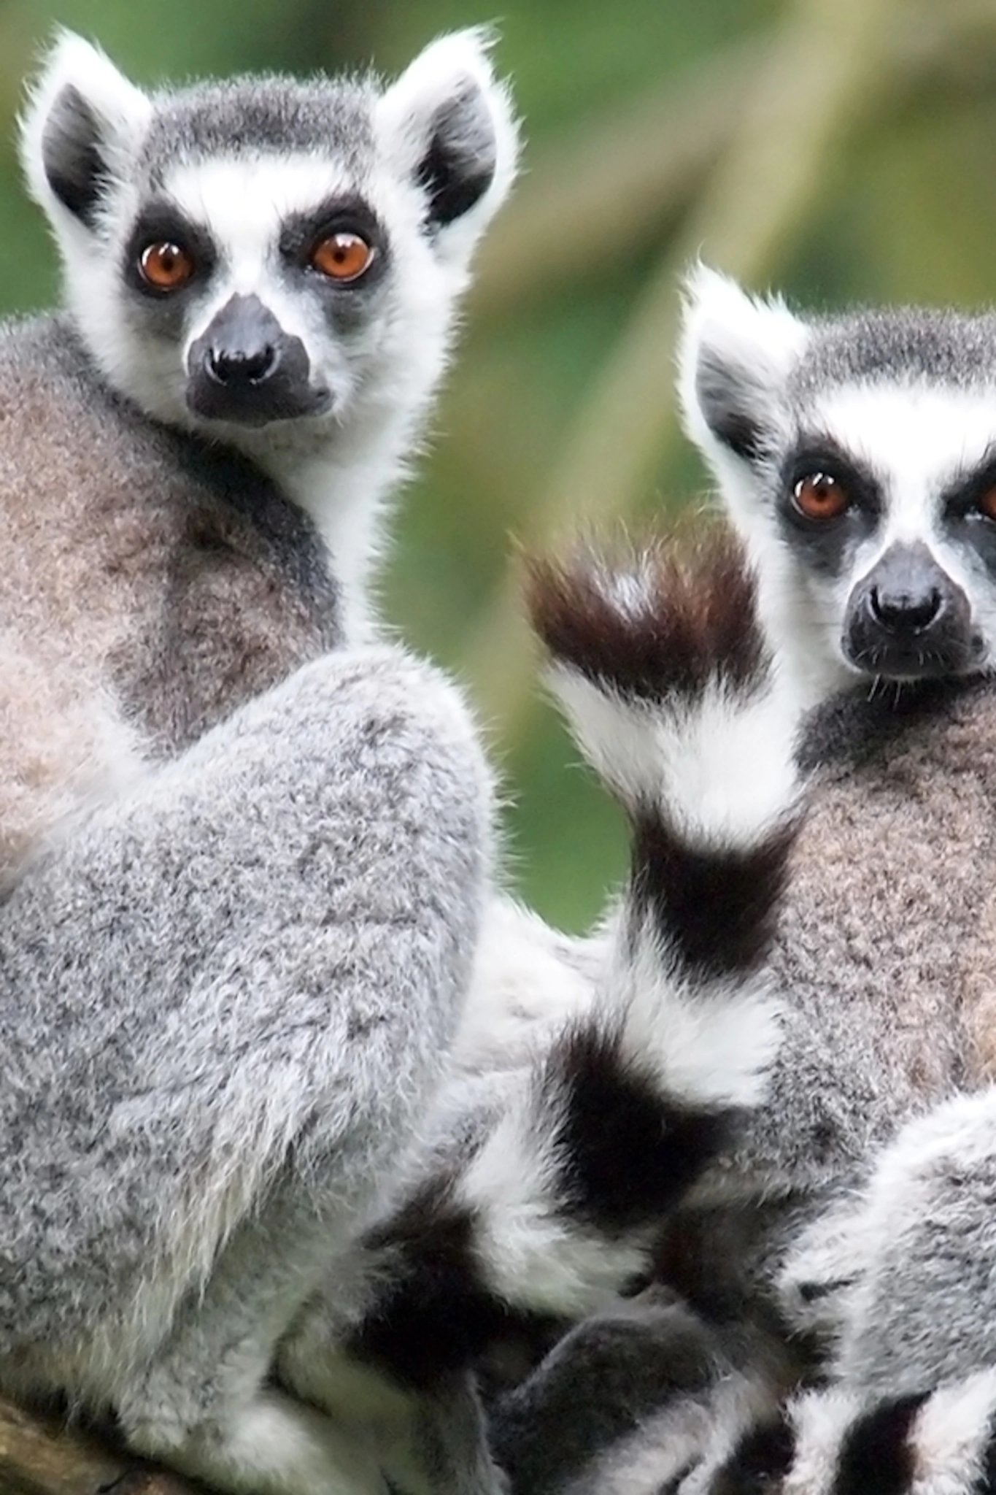
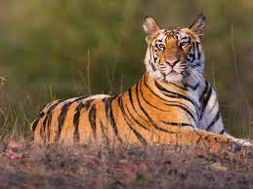
Types of wildlife in tropical evergreen forest
Few of the common animal species found in tropical evergreen forests are monkeys, tigers, elephants, deer, lemur, one-horned rhino, birds, sloths, bats, scorpions, snails, etc.

Slide 8
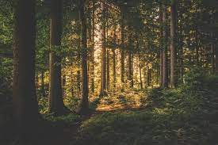
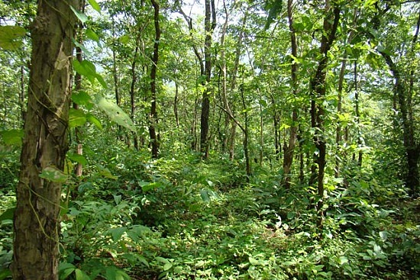
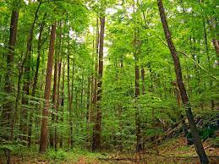
Advantages of tropical evergreen forests
help stabilize the world's climate;
provide a home to many plants and animals;
maintain the water cycle.
protect against flood, drought, and erosion;
are a source for medicines and foods;
support tribal people; and.
are an interesting place to visit.

